Slide 1
BOOTSTRAP

Slide 2
WHAT IS BOOTSTRAP?
HTML, CSS and JavaScript framework.
The world’s most popular front-end open source toolkit.
It has responsive grid system, extensive prebuild components.
Twitter Bootstrap is the most popular front end framework in the recent time.

Slide 3
WHY BOOTSTRAP?
100% Open Source Framework.
Very Easy to use in our website.
Responsive features for various like phones, tablets and desktop etc..
Bootstrap mainly for mobile firs approach.
It is compatibility for all modern browsers like chrome, Firefox etc..
Easy to get started

Slide 4
Why to Learn Bootstrap?
Mobile first approach − Bootstrap 3, framework consists of Mobile first styles throughout the entire library instead them of in separate files.
Browser Support − It is supported by all popular browsers.
Easy to get started − With just the knowledge of HTML and CSS anyone can get started with Bootstrap. Also the Bootstrap official site has a good documentation.
Responsive design − Bootstrap's responsive CSS adjusts to Desktops, Tablets and Mobiles. More about the responsive design is in the chapter Bootstrap Responsive Design.

Slide 5
Cont…
Provides a clean and uniform solution for building an interface for developers.
It contains beautiful and functional built-in components which are easy to customize.
It also provides web based customization.
And best of all it is an open source.

Slide 6
HISTORY OF BOOTSTRAP
Bootstrap was developed by Mark Otto and Jacob Thornton at Twitter,
It is released as an open source product in August 2011 on GitHub.
In June 2014 Bootstrap was the No.1 Project on GitHub.

Slide 7
Applications of Bootstrap
Scaffolding − Bootstrap provides a basic structure with Grid System, link styles, and background. This is is covered in detail in the section Bootstrap Basic Structure
CSS − Bootstrap comes with the feature of global CSS settings, fundamental HTML elements styled and enhanced with extensible classes, and an advanced grid system. This is covered in detail in the section Bootstrap with CSS.
Components − Bootstrap contains over a dozen reusable components built to provide iconography, dropdowns, navigation, alerts, pop-overs, and much more. This is covered in detail in the section Layout Components.

Slide 8
Cont…
JavaScript Plugins − Bootstrap contains over a dozen custom jQuery plugins. You can easily include them all, or one by one. This is covered in details in the section Bootstrap Plugins.
Customize − You can customize Bootstrap's components, LESS variables, and jQuery plugins to get your very own version.

Slide 9
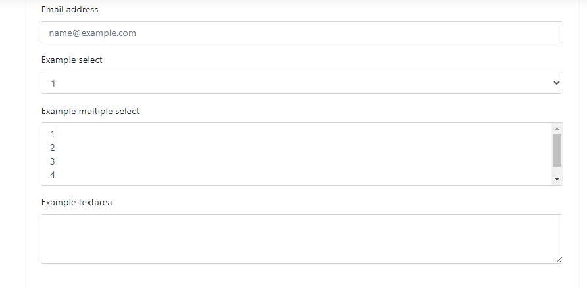
Form controls

Slide 10
Bootstrap - Grid System
What is a Grid?
In graphic design, a grid is a structure (usually two-dimensional) made up of a series of intersecting straight (vertical, horizontal) lines used to structure the content. It is widely used to design layout and content structure in print design. In web design, it is a very effective method to create a consistent layout rapidly and effectively using HTML and CSS.
in simple words, grids in web design organise and structure content, makes the websites easy to scan and reduces the cognitive load on users.

Slide 11
What is Bootstrap Grid System?
Bootstrap includes a responsive, mobile first fluid grid system that appropriately scales up to 12 columns as the device or viewport size increases. It includes predefined classes for easy layout options, as well as powerful mixins for generating more semantic layouts.
Mobile First Strategy
Content
Determine what is most important.
Layout
Design to smaller widths first.
Base CSS address mobile device first; media queries address for tablet, desktops.
Progressive Enhancement
Add elements as screen size increases.

Slide 12
Cont.. Class
col-lg- stands for column large ≥ 1200px. col-md- stands for column medium ≥ 992px. col-xs- stands for column extra small ≥ 768px. The pixel numbers are the breakpoints, so for example col-xs is targeting the element when the window is smaller than 768px(likely mobile devices)..

Slide 13
Working of Bootstrap Grid System
Grid systems are used for creating page layouts through a series of rows and columns that house your content. Here's how the Bootstrap grid system works −
Rows must be placed within a .container class for proper alignment and padding.
Use rows to create horizontal groups of columns.
Content should be placed within the columns, and only columns may be the immediate children of rows.
Predefined grid classes like .row and .col-xs-4 are available for quickly making grid layouts. LESS mixins can also be used for more semantic layouts.
Columns create gutters (gaps between column content) via padding. That padding is offset in rows for the first and the last column via negative margin on .rows.
Grid columns are created by specifying the number of twelve available columns you wish to span. For example, three equal columns would use three .col-xs-4.

Slide 14
Media Queries
Media query is a really fancy term for "conditional CSS rule". It simply applies some CSS, based on certain conditions set forth. If those conditions are met, the style is applied.
Media Queries in Bootstrap allow you to move, show and hide content based on the viewport size. Following media queries are used in LESS files to create the key breakpoints in the Bootstrap grid system.

Slide 15
Example
/* Extra small devices (phones, less than 768px) */
/* No media query since this is the default in Bootstrap */
/* Small devices (tablets, 768px and up) */
@media (min-width: @screen-sm-min) { ... }
/* Medium devices (desktops, 992px and up) */
@media (min-width: @screen-md-min) { ... }
/* Large devices (large desktops, 1200px and up) */
@media (min-width: @screen-lg-min) { ... }

Slide 16
Cont.. Class
The Bootstrap grid system has four classes: xs (phones), sm (tablets), md (desktops), and lg (larger desktops). The classes can be combined to create more dynamic and flexible layouts.
A clearfix is a way for an element to clear its child elements automatically without any additional markup.
A block level button spans the entire width of the parent element.

